Slide 1
A First Book of ANSI C Fourth Edition
Chapter 6
Modularity Using Functions: Part I

Slide 2
Objectives
Function and Parameter Declarations
Returning a Value
Case Study: Calculating Age Norms
Standard Library Functions
Common Programming and Compiler Errors

Slide 3
Function and Parameter Declarations
A function that is called into action by its reference in another function is a called function
A function that calls another function is referred to as the calling function

Slide 4
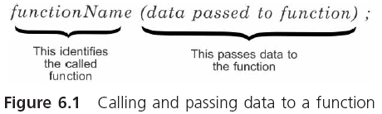
Function and Parameter Declarations (continued)

Slide 5
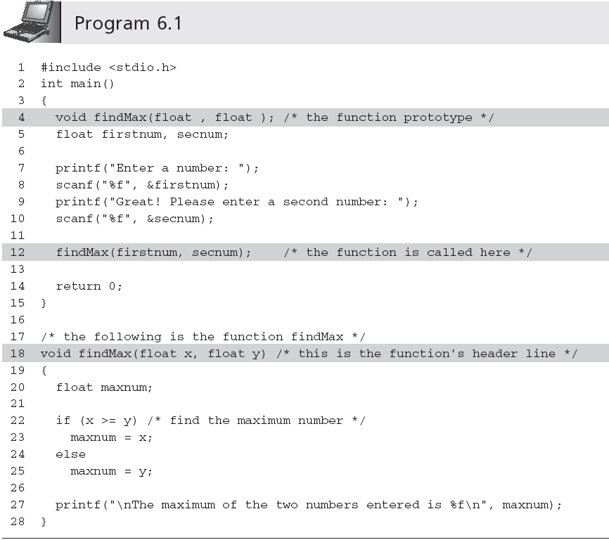
Function and Parameter Declarations (continued)

Slide 6
Function Prototypes
The declaration statement for a function is referred to as a function prototype
Declares the data type of the value that will be directly returned by the function
Declares the data type of the values that need to be transmitted to the called function when it is invoked
returnDataType functionName(argument data types);
Function prototypes allow the compiler to check for data type errors
If the function prototype does not agree with data types specified when the function is written, an error message (typically TYPE MISMATCH) will occur

Slide 7
Calling a Function
Arguments: items enclosed in parentheses in a function call statement
Other terms used as synonyms for arguments are actual arguments and actual parameters
Pass by value: when a function receives copies of the values in each argument and must determine where to store them before it does anything else
Also referred to as call by value

Slide 8
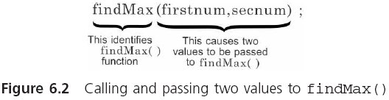
Calling a Function (continued)

Slide 9
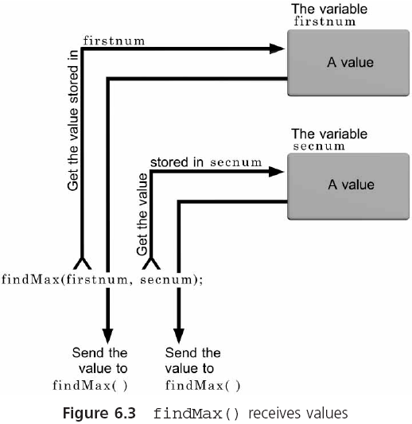
Calling a Function (continued)

Slide 10
Function Header Line
Function header: identifies the data type of the return value, provides the function with a name, and specifies the number, order, and type of values expected by the function
Function body: operates on the passed data and returns, at most, one value
The argument names in the header line are known as parameters or formal parameters and formal arguments

Slide 11
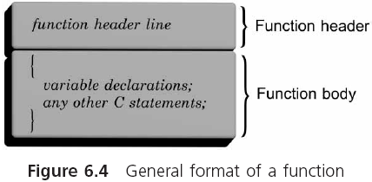
Function Header Line (continued)

Slide 12
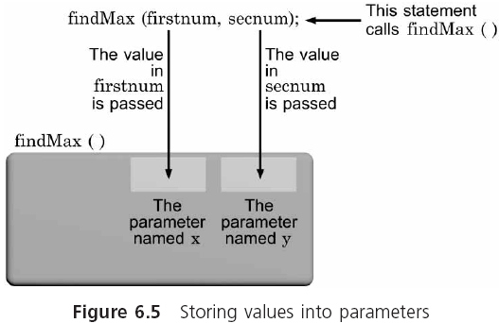
Function Header Line (continued)

Slide 13
Function Header Line (continued)
main() must adhere to the rules required for constructing all C functions
Some programmers prefer to put all called functions at the top of a program and make main() the last function listed
Each C function is a separate and independent entity with its own parameters and variables
Nested functions are not permitted
The function’s prototype, along with pre- and postconditions should provide all the information necessary to call the function successfully

Slide 14
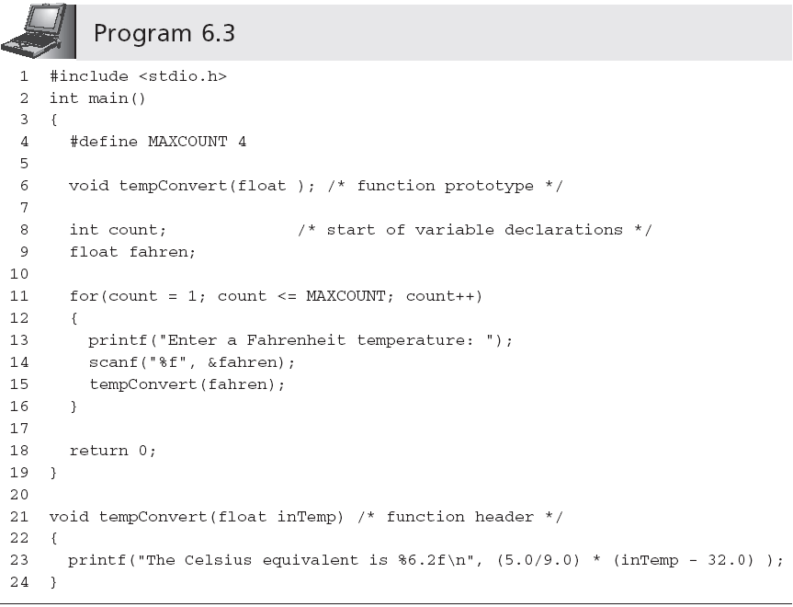
Function Header Line (continued)
Ends with a semicolon
Does not end with a semicolon

Slide 15
Placement of Statements
All preprocessor directives, variables, named constants, and functions, except main(), must be either declared or defined before they can be used
Basic (good) programming structure:
preprocessor directives
symbolic constants
function prototypes can be placed here
int main()
{
function prototypes can be placed here
variable declarations;
other executable statements;
return value;
}

Slide 16
Returning a Value
From its side of the return transaction, the called function must provide:
Data type of the returned value, which is specified in the function’s header line
Actual value being returned, which is specified by a return statement

Slide 17
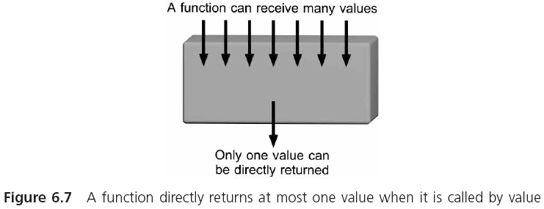
Returning a Value (continue)

Slide 18
Returning a Value (continue)
To return a value, use a return statement
return (expression); //or, return expression;
The expression is evaluated first; its value is then automatically converted to the return value’s data type as specified in the function’s header line before being sent back to the calling function
Failure to exactly match the return value with the function’s declared data type can lead to undesired results
Return value is converted to the data type declared in the function’s header line

Slide 19
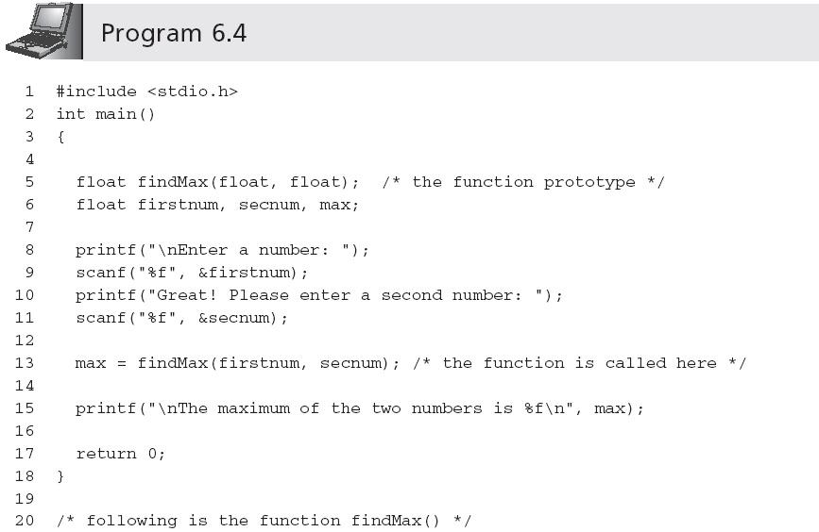
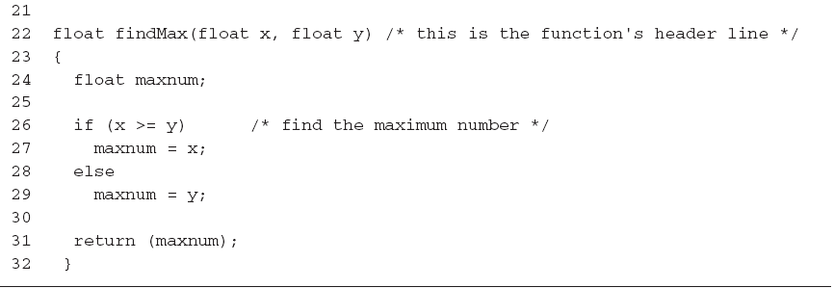
Returning a Value (continue)

Slide 20
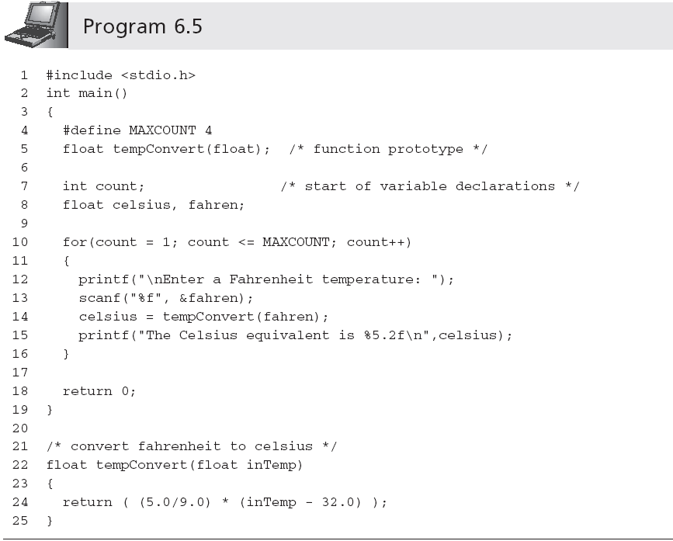
Returning a Value (continue)
printf("The Celsius equivalent is %5.2f\n", tempConvert(fahren));
Value is automatically converted from double to float (it may also generate a compiler warning message)

Slide 21
Function Stubs
A stub is the beginning of a final function, used as a placeholder until the final function is completed
float findMax(float x, float y)
{
printf("In findMax()\n");
printf("The value of x is %f\n", x);
printf("The value of x is %f\n ", y);
return 1.0;
}
A stub must compile and link with its calling module
Stub should display a message that it has been entered successfully and the value(s) of its received arguments

Slide 22
Functions with Empty Parameter Lists
The prototype for a function with empty parameter list requires either writing the keyword void or nothing between the parentheses following the function’s name
int display(void);
int display();
A function with an empty parameter list is called by its name with nothing written in the parentheses following the function’s name
display();

Slide 23
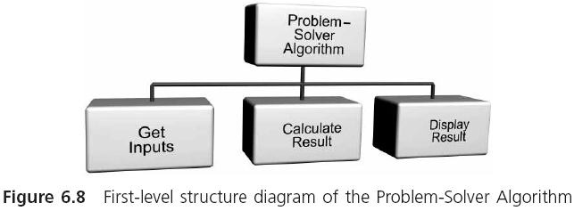
Case Study: Calculating Age Norms

Slide 24
Requirements Specification
A fairly common procedure in child development is to establish normal ranges for height and weight as they relate to a child’s age
These normal ranges are frequently referred to as age norms
In this case study, we develop a program for calculating both the expected height of a child between the ages of 6 and 11 and the deviation of this height norm to an actual child’s height

Slide 25
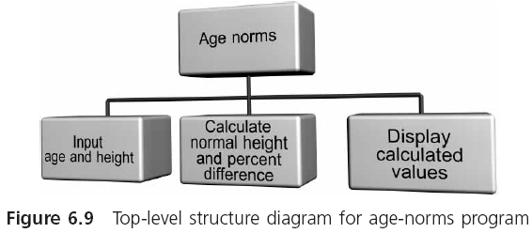
Requirements Specification (continued)

Slide 26
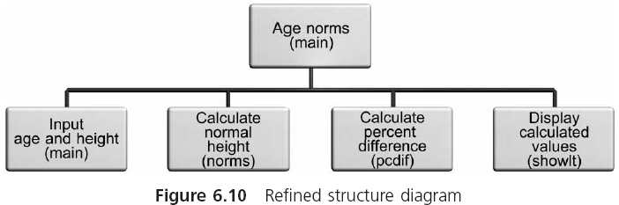
Requirements Specification (continued)

Slide 27
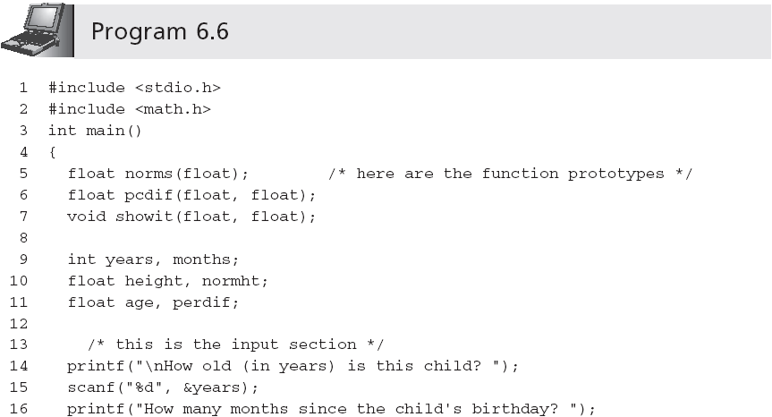
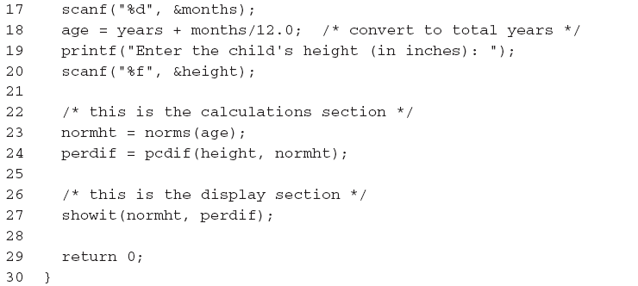
Requirements Specification (continued)

Slide 28
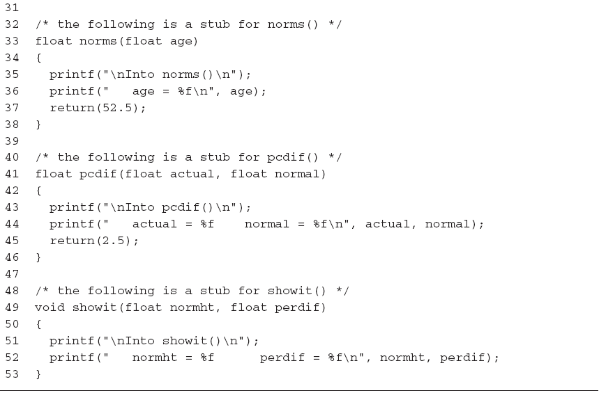
Requirements Specification (continued)

Slide 29
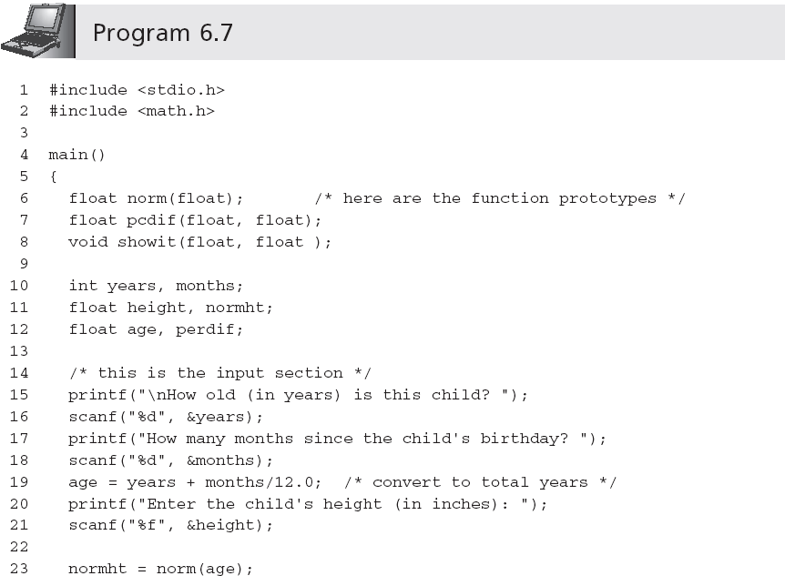
Requirements Specification (continued)

Slide 30
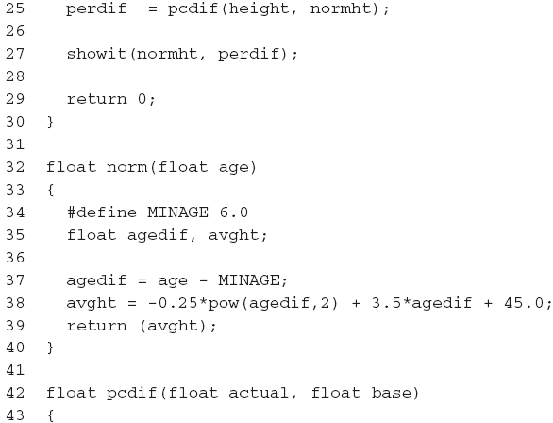
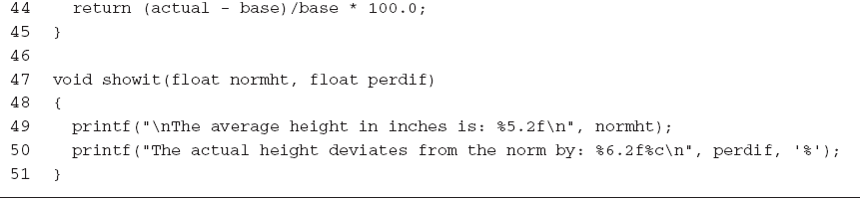
Requirements Specification (continued)

Slide 31
Standard Library Functions
The standard library consists of 15 header files
Before using these functions, you must know
The name of each available function
The arguments required by each function
The data type of the result (if any) returned by each function
A description of what each function does
How to include the library containing the desired function
#include <header-file-name>

Slide 32
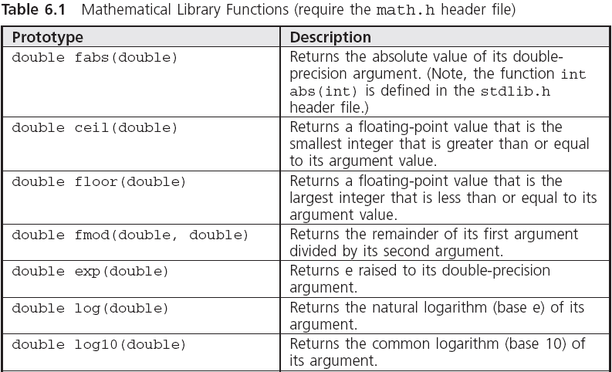
Mathematical Library Functions

Slide 33
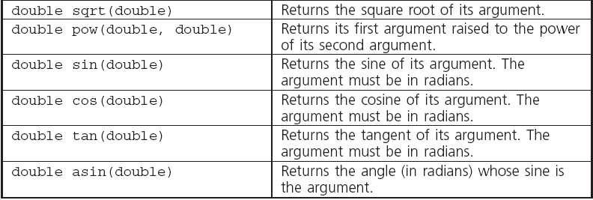
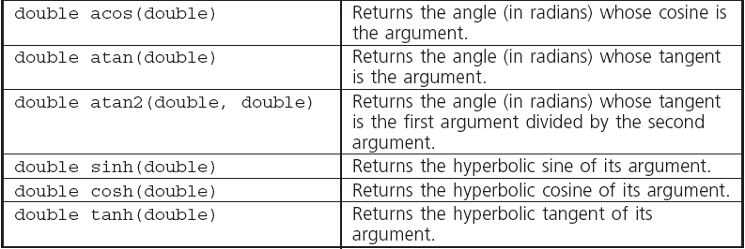
Mathematical Library Functions (continued)

Slide 34
The rand() and srand() Functions
Random numbers are a series of numbers whose order cannot be predicted
Pseudorandom numbers are not really random, but are sufficiently random for the task at hand
All C compilers provide two functions for creating random numbers: rand() and srand(), defined in the stdlib.h header file
rand() produces random numbers in the range 0 < rand() < RAND_MAX
srand() provides a starting “seed” value for rand()

Slide 35
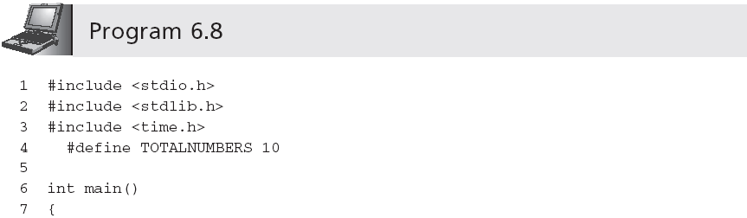
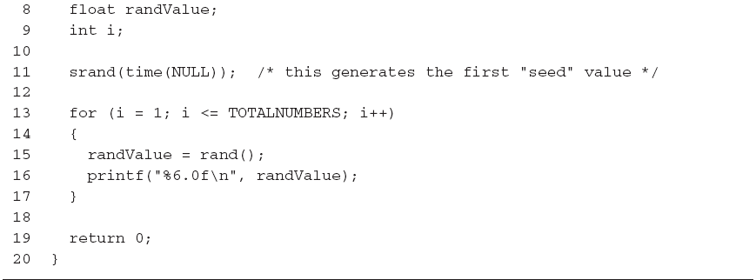
The rand() and srand() Functions (continued)

Slide 36
Scaling
The method for adjusting the random numbers produced by a random-number generator to reside within a specified range is called scaling
To scale a random number as an integer value between 1 and N:
1 + (int)rand() % N
To produce a random integer between the numbers a and b:
a + (int)(rand() % (b - a + 1))

Slide 37
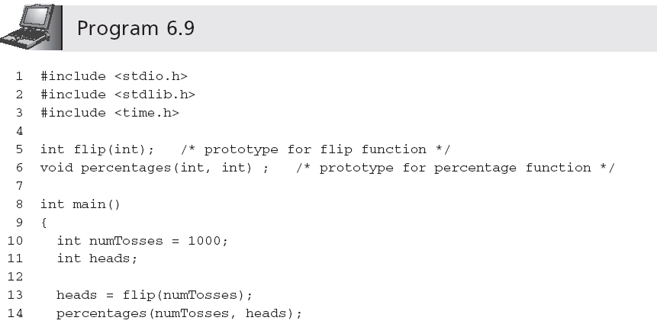

Coin Toss Simulation

Slide 38
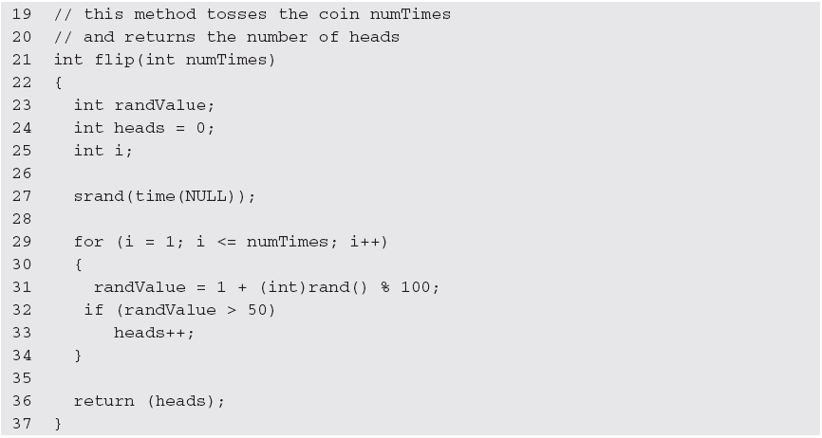
Coin Toss Simulation (continued)

Slide 39
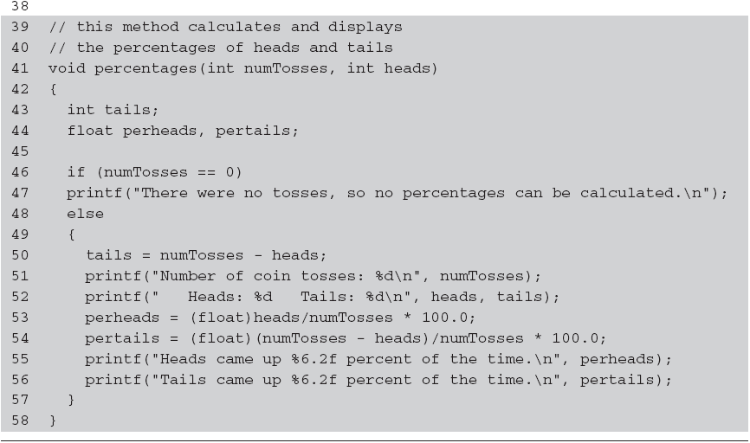
Coin Toss Simulation (continued)

Slide 40
Input/Output Library Functions
getchar() can be used for single character input
int getchar()
The reason for returning characters in integer format is to allow the End-Of-File (EOF) sentinel to be returned
putchar() expects a single character argument and displays the character passed to it on the terminal
For example, putchar('a')

Slide 41
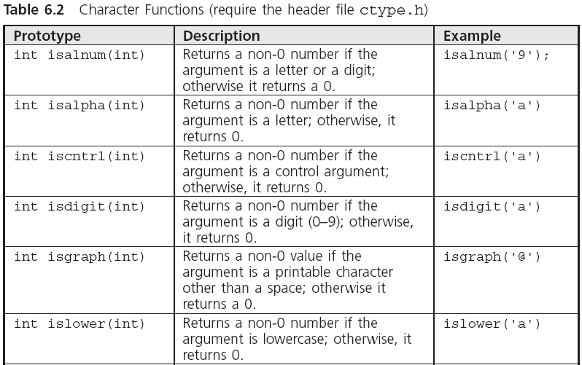
Character Processing Functions

Slide 42
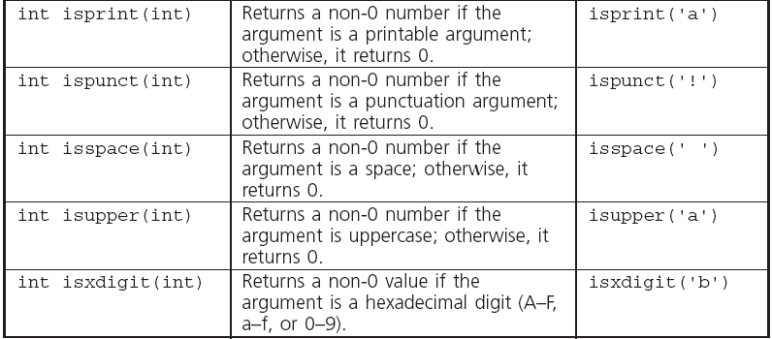
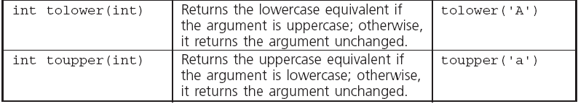
Character Processing Functions (continued)

Slide 43
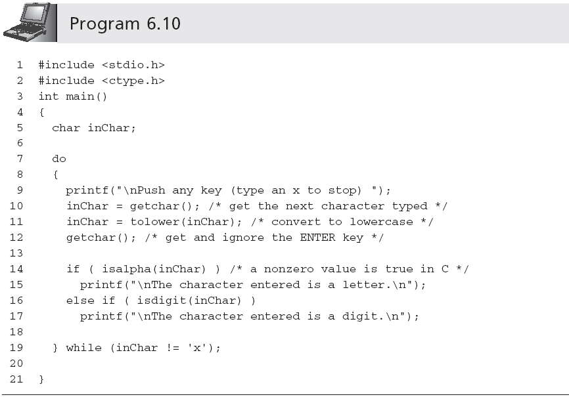
Character Processing Functions (continued)

Slide 44
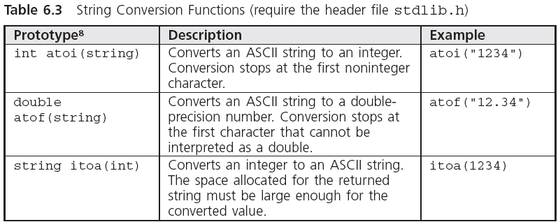
Conversion Functions

Slide 45
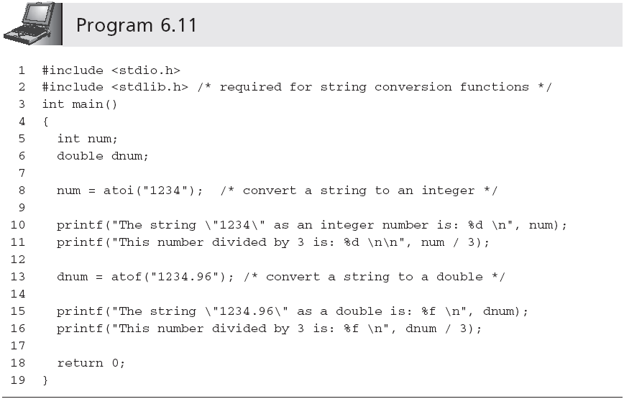
Conversion Functions (continued)

Slide 46
Common Programming Errors
Passing incorrect data types
Omitting a called function’s prototype
Terminating a function’s header line with a semicolon
Forgetting to include a data type for each parameter listed in a function’s header line
Returning a different data type from a function than the data type specified in the function’s header line

Slide 47
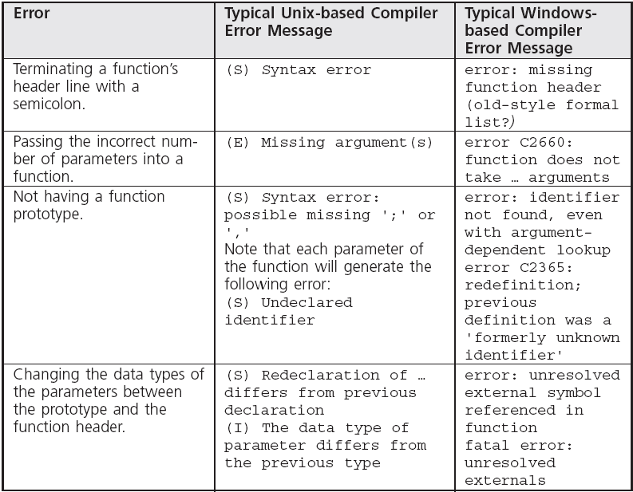
Common Compiler Errors

Slide 48
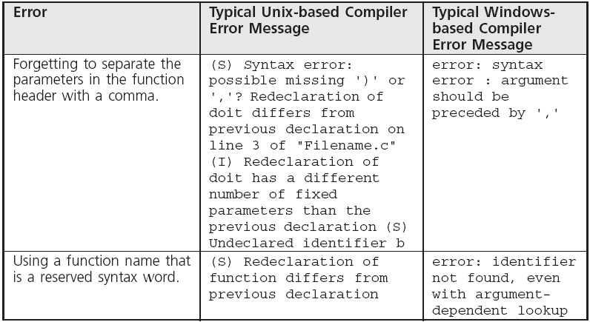
Common Compiler Errors (continued)

Slide 49
Summary
A function is called by giving its name and passing any data to it in the parentheses following the name
The first line of the function is called the function header
A function’s return type is the data type of the value returned by the function
Functions can directly return at most a single value to their calling functions

Slide 50
Summary (continued)
Functions can be declared to all calling functions with a function prototype
Arguments passed to a function provide a means of evaluating any valid C expression
A set of preprogrammed functions for mathematical calculations, character input and output, character processing, and numerical conversions are included in the standard library provided with each C compiler

